Slide 1

Predicting accident severity

Slide 2
Accident severity is important
Motor vehicle related crashed help all too frequently (10-year average of 1, 235, 145 crashed).
New York City(NYC) is the area of focus for this study and weather/traffic data will be analyzed.
Information like this can be important for creating safer driving conditions for everyone. It can also influence public decision/policy makers.
Previous academic studies suggest that weather DOES have an impact on accident severity.

Slide 3
Data acquisition and cleaning
Motor vehicle crash data obtained from NYC Open Data and local weather data was obtained from world weather online.
Original motor vehicle data contained almost 1.8 million regards dating as far back as 2012.
Multiple columns such as latitude, longitude, and vehicle type we eliminated because of a large amount of NaN data. Similar with the weather data, multiple columns deleted due to large amount of NaN data.
Data types were checked and changed to appropriate type. Example: the date fields for both sets of data required being changed to dataetime.
Both data sets were joined into one based on the date of the accident and the matching date in the weather data.
It was very important to clean the data as much as possible due to poor data quality.

Slide 4
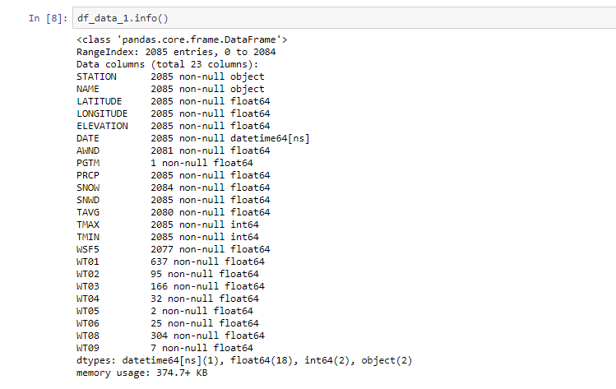
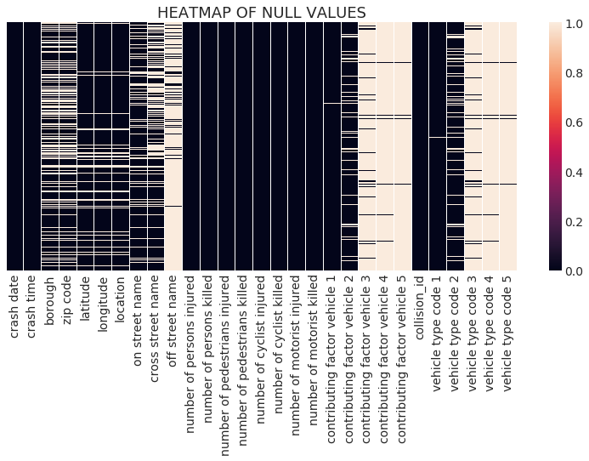
Data acquisition and cleaning cont..
Figure above is showing data type for motor vehicle data.
Heatmap of null values in the motor vehicle dataset.
This figure is a great visual for cleaning data and locations of nulls.

Slide 5
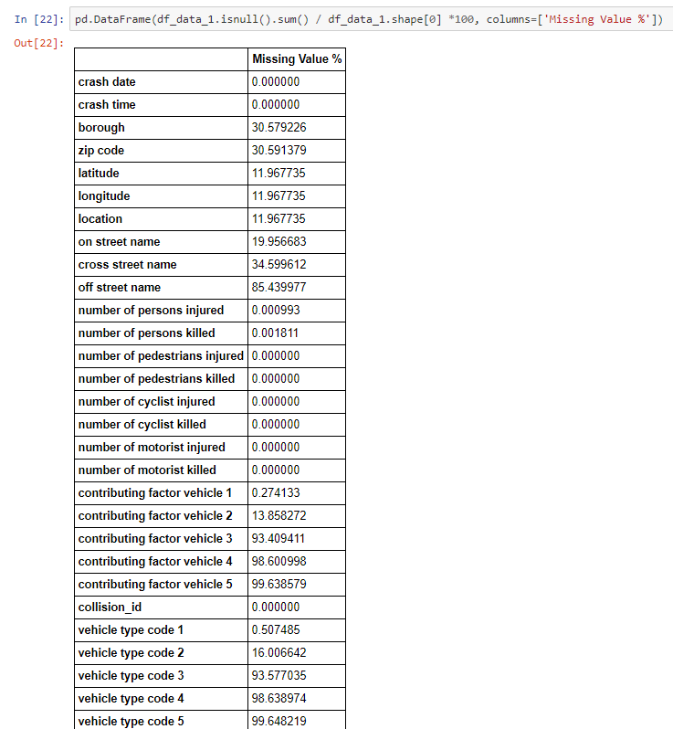
Feature Selection
This figure depicts another missing value chart I created.
This figure paired with the heatmap of null values was useful in cleaning the data
Motor vehicle accident data was filtered to after 1/1/2015. Much of the date prior to this date was very incomplete.
Much of the data was not in a complete format

Slide 6

Calculation of target variable
The number of injuries from motorist, pedestrians, and cyclists were summed into TOTAL INJURIES
The number of fatalities from motorist, pedestrians, and cyclists were summed into TOTAL FATALITIES
These columns were used to categorize the accident as “slight” which meant there were no injuries or fatalities.
“Serious” meant there was more than 1 injury but no fatalities. “Fatal” was defined as one or more fatality occurring.
This new column was labeled was “accident severity”
The image below is meant to breakdown the amount of accidents for a every 5 minute, hour. Day, week, month, and year period.

Slide 7
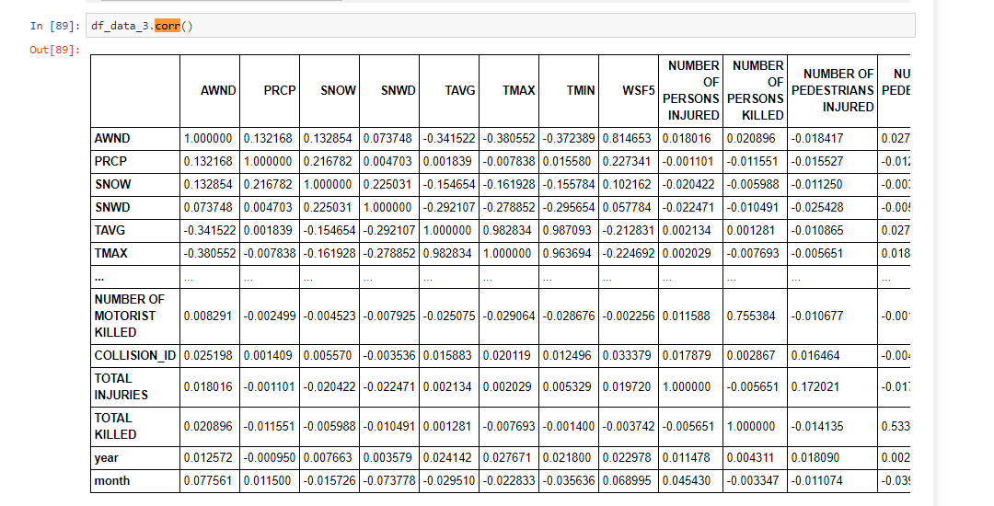
Exploratory analysis
The figure in this slide shows correlation with each variable after the join.
There is no significant correlation to take away here.
Columns were further divided for deeper analysis.

Slide 8
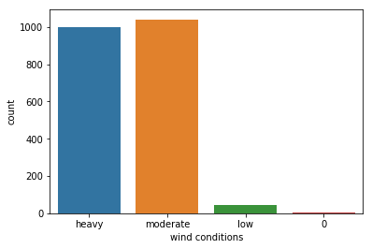
Relationship between accident severity of other variables
Average wind speed was further categorized:
Heavy wind - > 10 mph
Moderate wind – between 10 -5 mph
Low wind - < 5 mph
We can see heavy wind and moderate wind make up a vast majority of the days.
No relationship between wind and accident severity and insignificant P- value.
Over 600 “slight” accidents occurred during heavy wind.

Slide 9
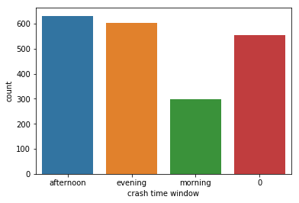
Relationship between accident severity of other variables cont…
Time of accident was divided further into:
Morning: 2am – 12 pm
Afternoon: 12pm – 5 pm
Evening: 5pm – 10 pm
Night: 10pm – 3 am
Accident times were prominent in the afternoon and evening. This likely due to peak (rush hour) traffic in NYC.

Slide 10
Predictive Modeling
It was determined classification works best with my data. I planned to use machine learning algorithms using Sckit-learn.
Further analysis determined regression was not preferred, along with k-nearest neighbors, and decision tree.
I found neural network was the best method, in particular multi-layer perceptron.
Due to time spent trying other machine learning methods and other steps along the way I did not have efficient time to build a complete model.
Working in traffic planning and engineering I am now very interested in this question of accident severity. Predictive modeling can be applied on a local level here in NYC transportation decisions.

Slide 11
Conclusion and Future Direction
The machine learning process did not go as expected due to the quality of data
The dataset was very flawed, to the point it made creating an accurate model for predicting accident severity very difficult.
Data quality is very important. Heavy emphasis should be put on quality data collection within local governments.
Working in traffic planning and engineering I plan on continuing to work on this by creating a multi-layer perceptron algorithm neural network.
Also additional information for the accidents such as driver age would be beneficial.
This is not to be said there is no relationship between weather conditions accident severity. Previous studies suggest there is a very strong relationship between weather and accident severity.

